Slide 1


IPL AUCTION

Slide 2

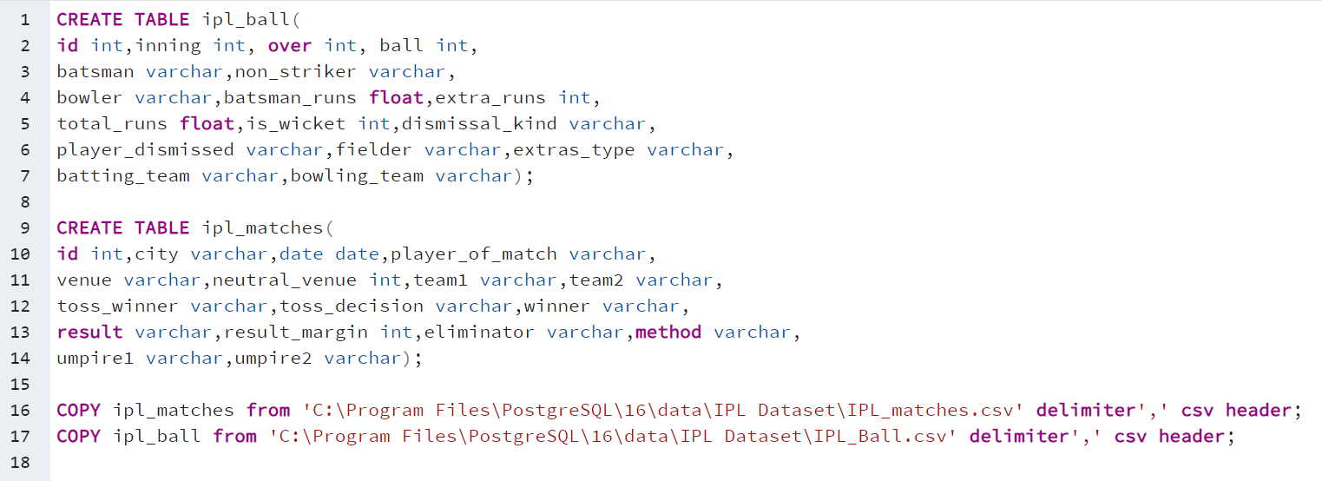

SQL QUERY FOR CREATING TABLES

Slide 3
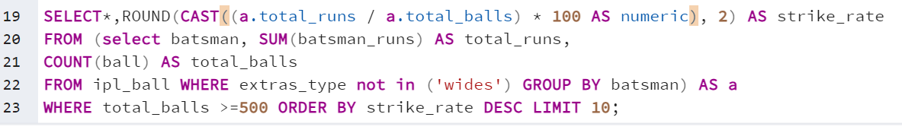
Aggressive batsmen
Criteria:1. Extra_type = wide not included.
2. Total balls faced >=500

Slide 4
List of 10 players with highest Strike rate
batsman | total_runs | total_balls | strike_rate
AD Russell | 1517 | 832 | 182.33
SP Narine | 892 | 543 | 164.27
HH Pandya | 1349 | 847 | 159.27
V Sehwag | 2728 | 1755 | 155.44
GJ Maxwell | 1505 | 973 | 154.68
RR Pant | 2079 | 1368 | 151.97
AB de Villiers | 4849 | 3192 | 151.91
CH Gayle | 4772 | 3179 | 150.11
KA Pollard | 3023 | 2017 | 149.88
JC Buttler | 1714 | 1146 | 149.56

Slide 5
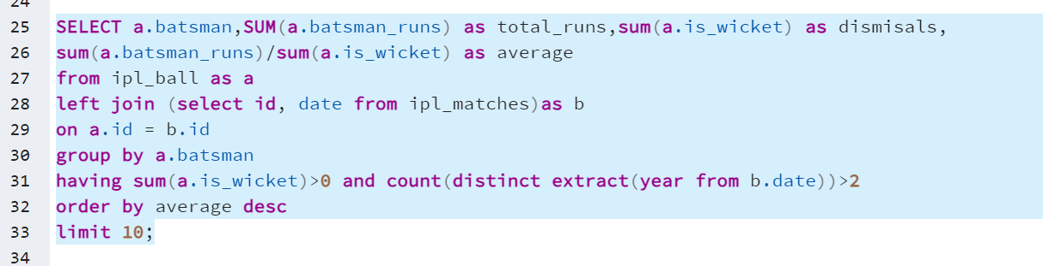
Anchor Batsman
Criteria:1. Batsman should have been dismissed at least once.
2.Batsman should have played more than 2 IPL seasons.

Slide 6
List of 10 players with highest Good Average score
batsman | total_runs | dismisals | average
Iqbal Abdulla | 88 | 1 | 88
KL Rahul | 2647 | 62 | 42.69
AB de Villiers | 4849 | 114 | 42.54
DA Warner | 5254 | 126 | 41.7
JP Duminy | 2029 | 49 | 41.41
CH Gayle | 4772 | 116 | 41.14
ML Hayden | 1107 | 27 | 41
LMP Simmons | 1079 | 27 | 39.96
KS Williamson | 1619 | 41 | 39.49
OA Shah | 506 | 13 | 38.92

Slide 7
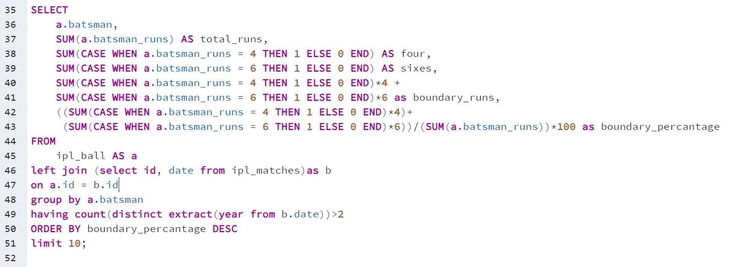
Hard-hitting players
Criteria:1. only 4 and 6 will be counted as boundaries.
2.Batsman should have played more than 2 IPL seasons.

Slide 8
List of 10 players with highest Boundary percentage
Batsman | Total_runs | Four | Sixes | Boundary_runs | Boundary_percantage
SP Narine | 892 | 103 | 52 | 724 | 81.16592
AD Russell | 1517 | 105 | 129 | 1194 | 78.70798
CH Gayle | 4772 | 384 | 349 | 3630 | 76.06873
CR Brathwaite | 181 | 10 | 16 | 136 | 75.13812
ST Jayasuriya | 768 | 84 | 39 | 570 | 74.21875
BCJ Cutting | 238 | 15 | 19 | 174 | 73.10924
MJ McClenaghan | 85 | 5 | 7 | 62 | 72.94118
AC Gilchrist | 2069 | 239 | 92 | 1508 | 72.88545
Mujeeb Ur Rahman | 11 | 2 | 0 | 8 | 72.72727
MS Gony | 99 | 6 | 8 | 72 | 72.72727

Slide 9
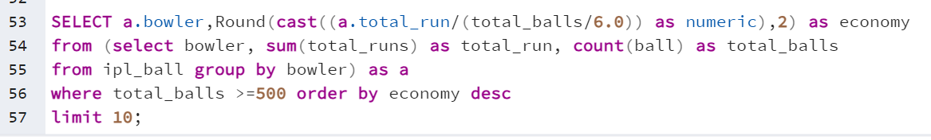
Good Economy Bowlers
Criteria:1. Bowler should have bowled at least 500 balls in IPL

Slide 10
List of 10 players with Good Economy Bowlers
bowler | economy
MP Stoinis | 9.28
M Prasidh Krishna | 9
AS Rajpoot | 8.93
BB Sran | 8.92
DR Smith | 8.89
AD Russell | 8.82
HH Pandya | 8.8
Mohammed Shami | 8.76
Mohammed Siraj | 8.74
JD Unadkat | 8.71

Slide 11
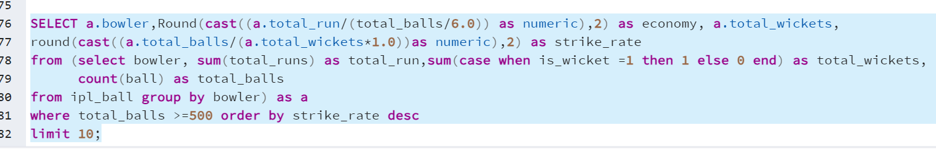
Best strike rate Bowler
Criteria:1. Bowler should have bowled at least 500 balls in IPL and should have high strike rate.

Slide 12
List of 10 players with best bowling strike rate
bowler | economy | total_wickets | strike_rate
SK Raina | 7.35 | 30 | 31
NA Saini | 8.13 | 19 | 30.89
CH Gayle | 7.76 | 19 | 30.74
B Lee | 7.38 | 30 | 30.53
JP Duminy | 7.25 | 23 | 30.48
M Kartik | 7.2 | 39 | 30.31
AD Mathews | 8.14 | 28 | 28.82
GJ Maxwell | 8.45 | 20 | 27.9
I Sharma | 7.97 | 73 | 27.64
TG Southee | 8.47 | 34 | 27.41

Slide 13
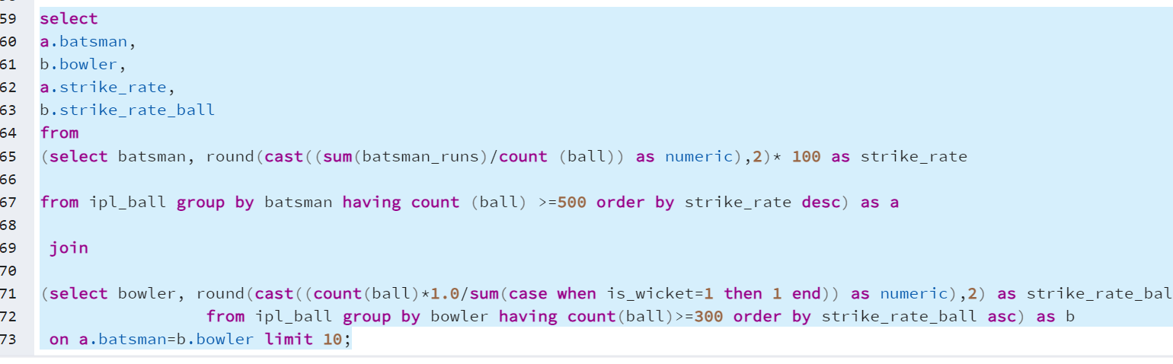
All-rounders
Criteria: 1. Player should have faced at least 500 balls in IPL.
2.Player should have bowled more than 300 balls in IPL.

Slide 14
List of 10 players as all rounder
batsman | strike_rate | strike_rate_ball
AD Russell | 172 | 17.7
SP Narine | 156 | 19.75
HH Pandya | 150 | 20.31
GJ Maxwell | 149 | 27.9
CH Gayle | 143 | 30.74
KA Pollard | 143 | 19.92
YK Pathan | 138 | 25.74
KH Pandya | 138 | 26.18
JA Morkel | 137 | 18.82
SR Watson | 134 | 19.97

Slide 15
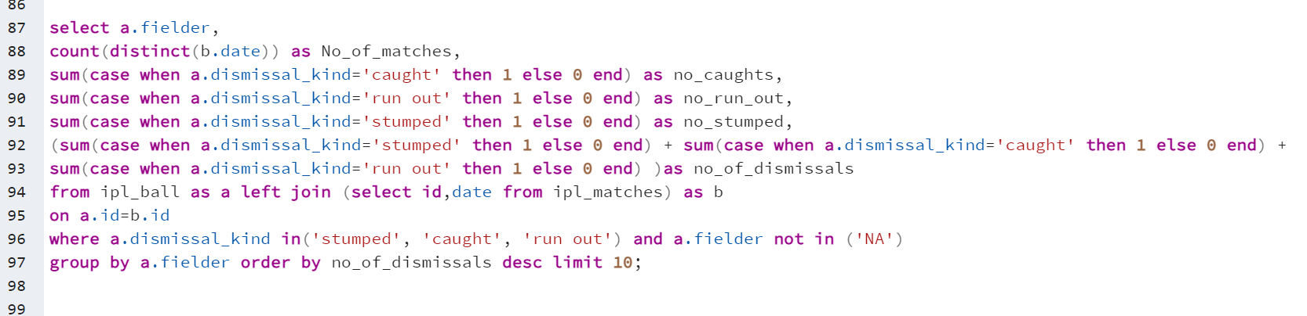
Wicketkeeper
A perfect wicketkeeper keeps the morale of the team high and acts as the confidence booster to the bowler and the entire team. The performance of a wicketkeeper in a match can change the fate of the game. A wicketkeeper should be capable of several cricketing skills like stamping, catching and appealing for a dismissal and in these days an important decision maker of call for a decision review.
Criteria: The data is filtered using a where clause, focusing only on entries where the dismssal_kind is 'stumped', 'caught', or 'run out'. Any entry with a fielder labeled 'NA' is excluded. Also no of matches played by each player has been included in the analysis.

Slide 16
List of wicket keepers with high number of dismissals
fielder | no_of_matches | no_caughts | no_run_out | no_stumped | no_of_dismissals
MS Dhoni | 106 | 113 | 12 | 39 | 164
KD Karthik | 104 | 118 | 8 | 30 | 156
RV Uthappa | 84 | 87 | 4 | 32 | 123
AB de Villiers | 86 | 103 | 6 | 8 | 117
SK Raina | 81 | 99 | 6 | 0 | 105
RG Sharma | 74 | 88 | 4 | 0 | 92
PA Patel | 69 | 69 | 6 | 16 | 91
KA Pollard | 67 | 84 | 4 | 0 | 88
V Kohli | 69 | 76 | 7 | 0 | 83
WP Saha | 56 | 62 | 1 | 20 | 83
* Best two wicket keeper are highlighted in list

Slide 17
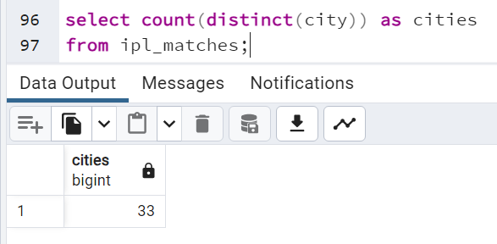
Additional Questions for Final Assessment
Question 1. Get the count of cities that have hosted an IPL match

Slide 18
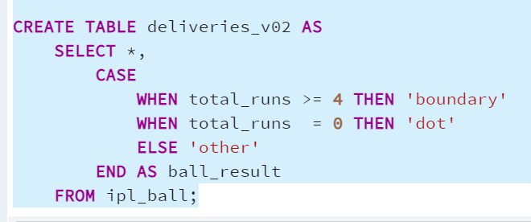
Additional Questions for Final Assessment
Question 2. Create table deliveries_v02 with all the columns of the table ‘deliveries’ and an additional column ball_result containing values boundary, dot or other depending on the total_run (boundary for >= 4, dot for 0 and other for any other number)

Slide 19
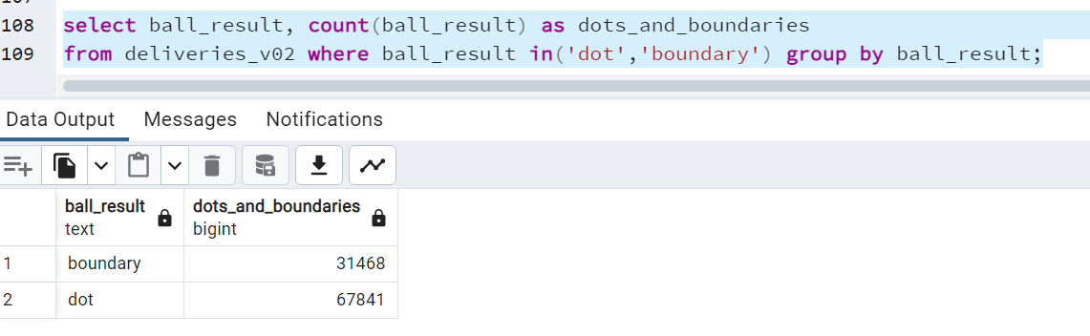
Additional Questions for Final Assessment
Question 3. Write a query to fetch the total number of boundaries and dot balls from the deliveries_v02 table.

Slide 20
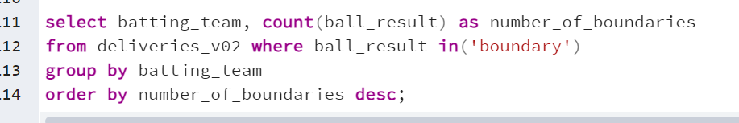
Additional Questions for Final Assessment
Question 4. Write a query to fetch the total number of boundaries scored by each team from the deliveries_v02 table and order it in descending order of the number of boundaries scored
batting_team | number_of_boundaries
Mumbai Indians | 4118
Royal Challengers Bangalore | 3800
Kings XI Punjab | 3780
Kolkata Knight Riders | 3739
Chennai Super Kings | 3496
Rajasthan Royals | 3041
Delhi Daredevils | 3022
Sunrisers Hyderabad | 2306
Deccan Chargers | 1387
Pune Warriors | 733
Delhi Capitals | 659
Gujarat Lions | 624
Rising Pune Supergiant | 290
Rising Pune Supergiants | 242
Kochi Tuskers Kerala | 231

Slide 21
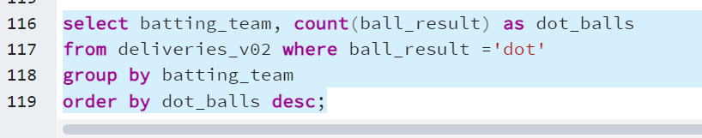
Additional Questions for Final Assessment
Question 5.Write a query to fetch the total number of dot balls bowled by each team and order it in descending order of the total number of dot balls bowled.
batting_team | dot_balls
Mumbai Indians | 8756
Kolkata Knight Riders | 8017
Royal Challengers Bangalore | 7988
Kings XI Punjab | 7858
Chennai Super Kings | 7389
Rajasthan Royals | 6762
Delhi Daredevils | 6592
Sunrisers Hyderabad | 4944
Deccan Chargers | 3227
Pune Warriors | 2099
Delhi Capitals | 1324
Gujarat Lions | 1153
Rising Pune Supergiant | 616
Kochi Tuskers Kerala | 595
Rising Pune Supergiants | 521

Slide 22
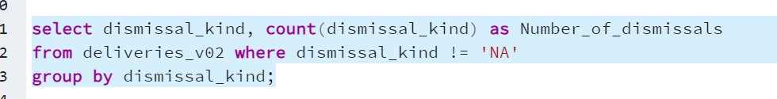
Additional Questions for Final Assessment
Question 6. Write a query to fetch the total number of dismissals by dismissal kinds where dismissal kind is not NA.
dismissal_kind | number_of_dismissals
bowled | 1700
caught | 5743
caught and bowled | 269
hit wicket | 12
lbw | 571
obstructing the field | 2
retired hurt | 11
run out | 893
stumped | 294

Slide 23
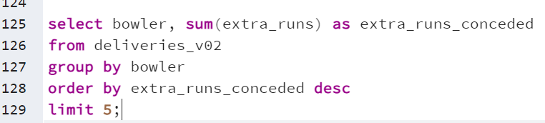
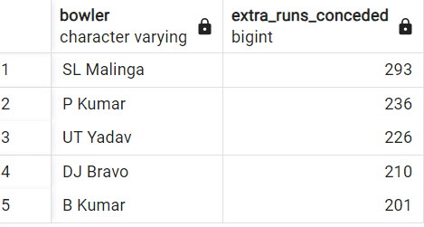
Additional Questions for Final Assessment
Question 7. Write a query to get the top 5 bowlers who conceded maximum extra runs from the deliveries table.

Slide 24
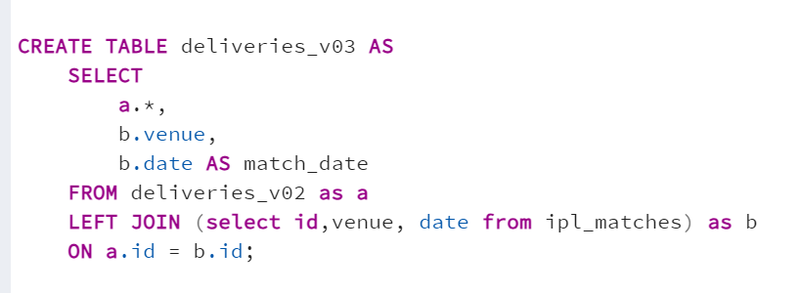
Additional Questions for Final Assessment
Question 8.Write a query to create a table named deliveries_v03 with all the columns of deliveries_v02 table and two additional column (named venue and match_date) of venue and date from table matches .

Slide 25
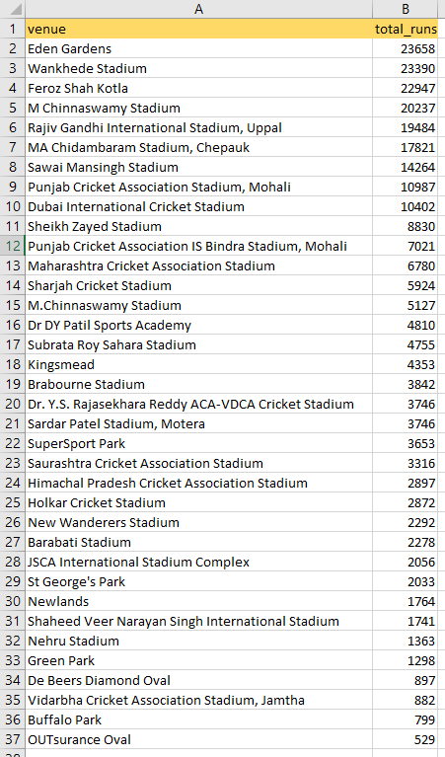
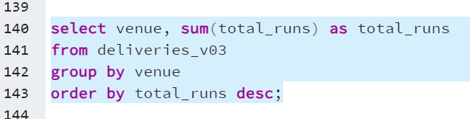
Additional Questions for Final Assessment
Question 9. Write a query to fetch the total runs scored for each venue and order it in the descending order of total runs scored.

Slide 26
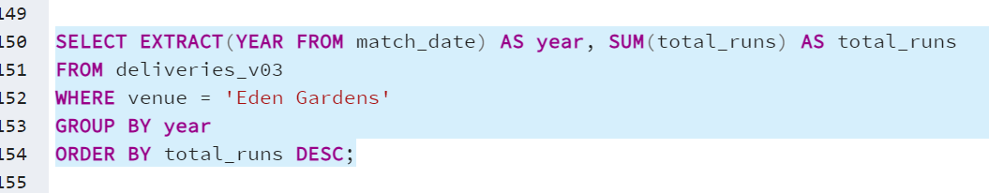
Additional Questions for Final Assessment
Question 10. Write a query to fetch the year-wise total runs scored at Eden Gardens and order it in the descending order of total runs scored.
year | total_runs
2018 | 2885
2019 | 2651
2015 | 2386
2013 | 2304
2017 | 2194
2010 | 2167
2016 | 2073
2012 | 2012
2011 | 1854
2008 | 1843
2014 | 1289

Slide 27
Thank You

